Slide 1
MCU TNC Design
David Cain, Kobe Keopraseuth, David Cain
Design 1
FINAL PRESENTATION

Slide 2


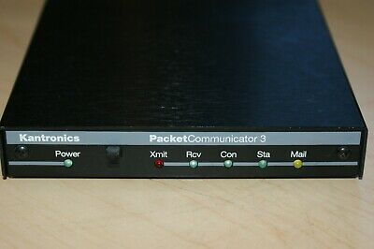
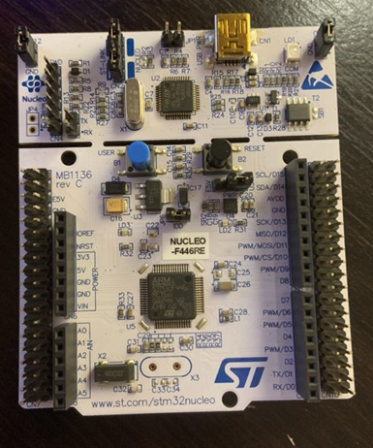
Project Overview
Design a compact efficient Terminal Node Controller using the STM32 platform
Radio
Radio

Slide 3
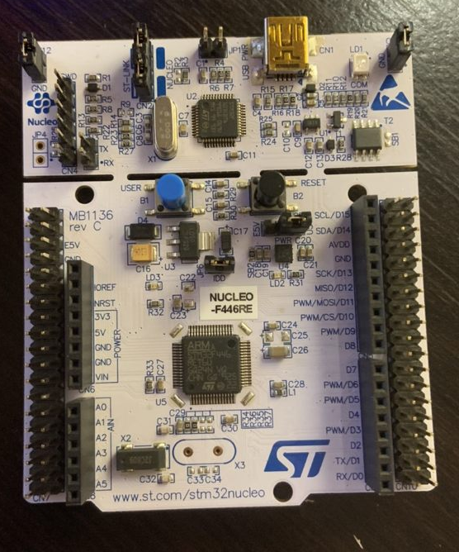
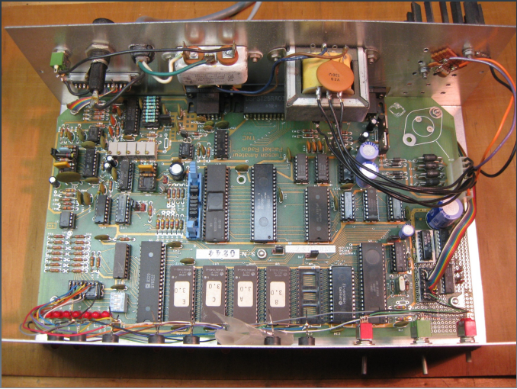
STM32 TNC
TAPR TNC-1
Full Setup: $53
Full Setup: ~ $140
VS.
Size: 2’’x2’’
Logic:
Coded in C without much external hardware of chips
Hardware:
Nucleo STM32 Board
Documentation:
Easier to document code ( also easier to find and reuse)
Nucleo Board is proprietary hardware and well documented and tested
Size: 1’x6’’
Logic:
Data formatted mostly by analog logic chips
Hardware:
Many circuits in addition to many integrated chips
Documentation:
Not well documented
hard to find info to repair if something is wrong
many different designs so only people who make these know how to fix them

Slide 4
Design Process

Slide 5
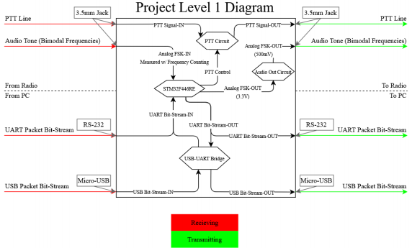
Scope of Work & Functional Block Diagram
To Implement and design a Terminal node Controller using the STM32 platform that is capable receiving and transmitting data packets, serving as a modem between a PC and a radio.

Slide 6
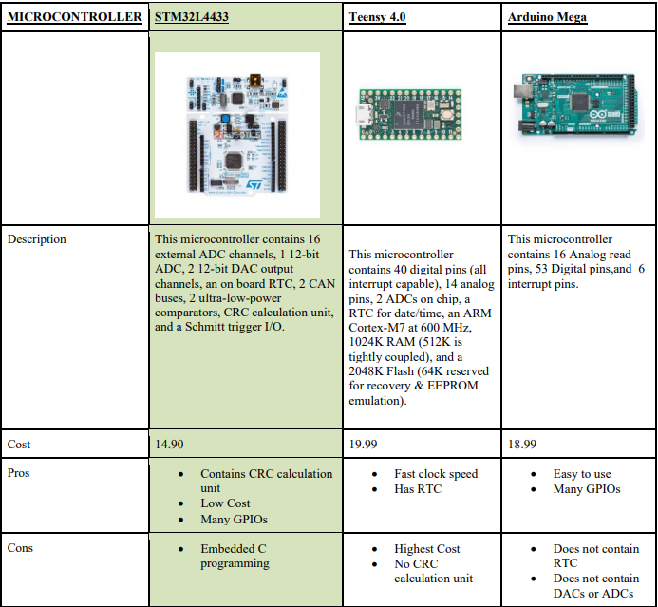
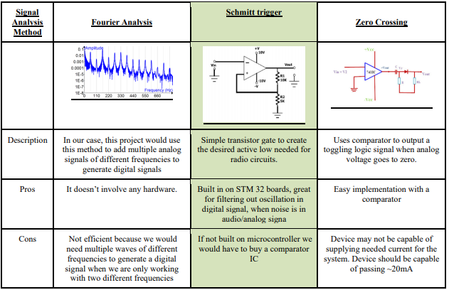
Alternatives and Tradeoffs

Slide 7
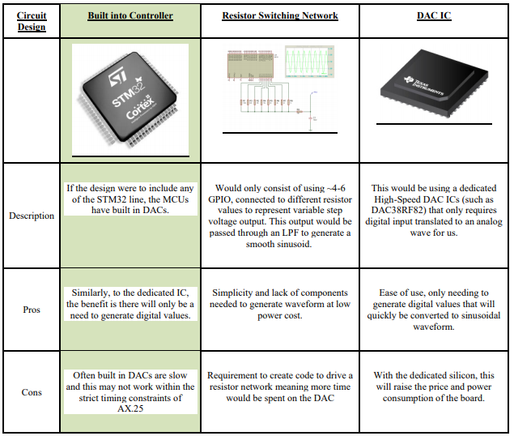
Alternatives and Tradeoffs

Slide 8
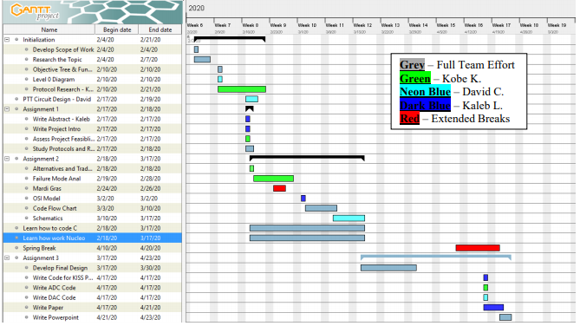
Feasibility Analysis

Slide 9
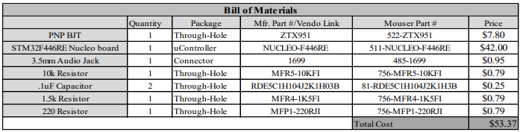
Feasibility Analysis

Slide 10
Software Flow Breakdown

Slide 11
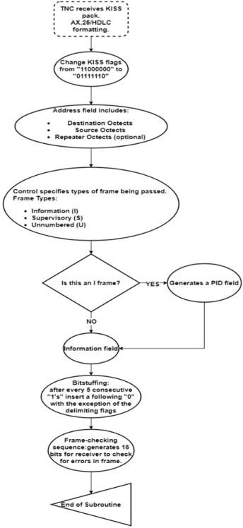
Kiss Packet to AX.25
VALIDATION/TESTING:
Create our own packets of which we know what the data section says (example in HEX “Hello world”). This HEX packet is sent to the TNC over the USB. It is then picked apart for its data section. This data section is then translated back into HEX then Ascii and outputted to serial. We monitor this serial to see if it is outputting the correct data.

Slide 12
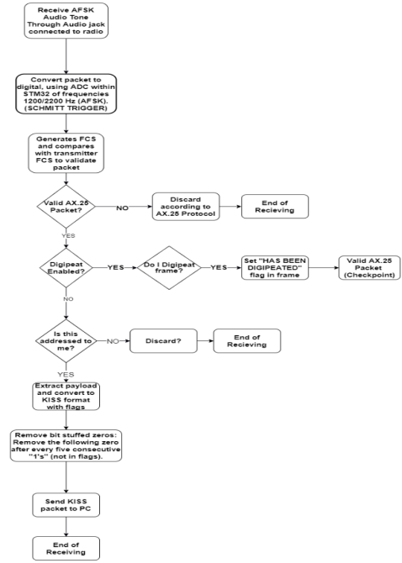
Receiving Mode (Analog to Digital)

Slide 13
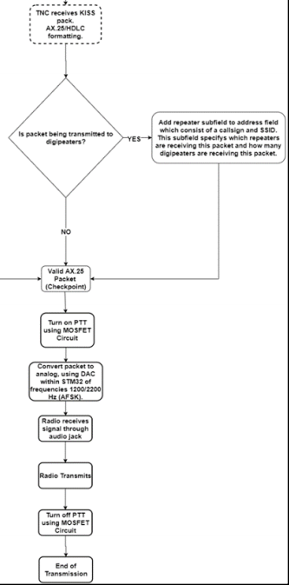
Transmitting (Digital to Analog)

Slide 14
Modulation and Demodulation Validation
A short binary bitstream is hardcoded to be sent to the DAC
The microcontroller saves this bit stream to a memory location that is reference and then parsed through as it is sent to the DAC
The DAC creates an audio signal that is sent over wire back into the TNC where it is demodulated at the ADC code block
If the data returns the same as what was sent out the process is valid.

Slide 15
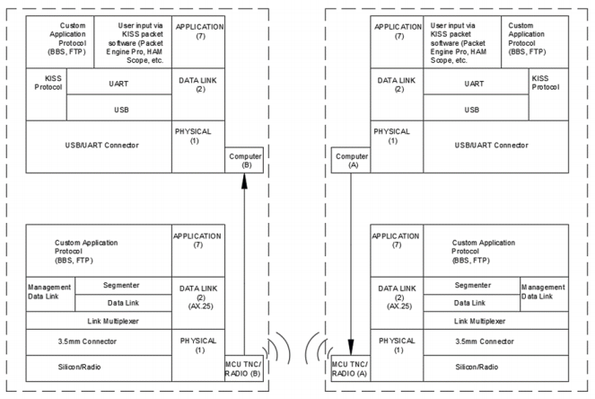
OSI Layered Communication Model

Slide 16
Hardware Validation and Simulation
BJT Push to Talk Circuit

Slide 17
Hardware Validation and Simulation
Voltage Divider to Control Voltage Output

Slide 18
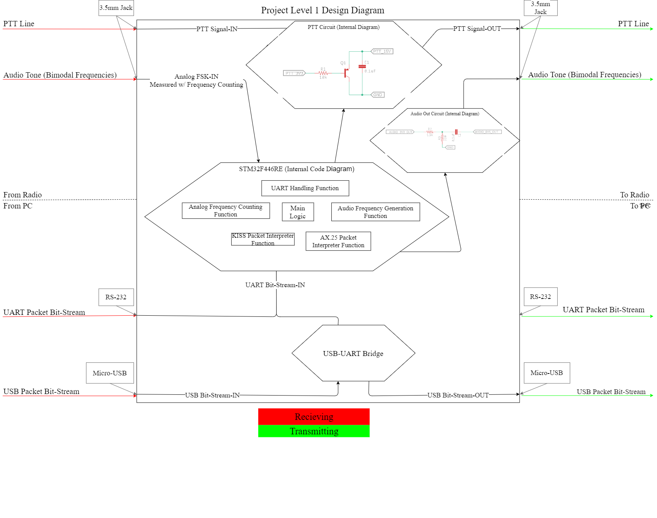
Final Design: Level 1 Design Diagram

Slide 19
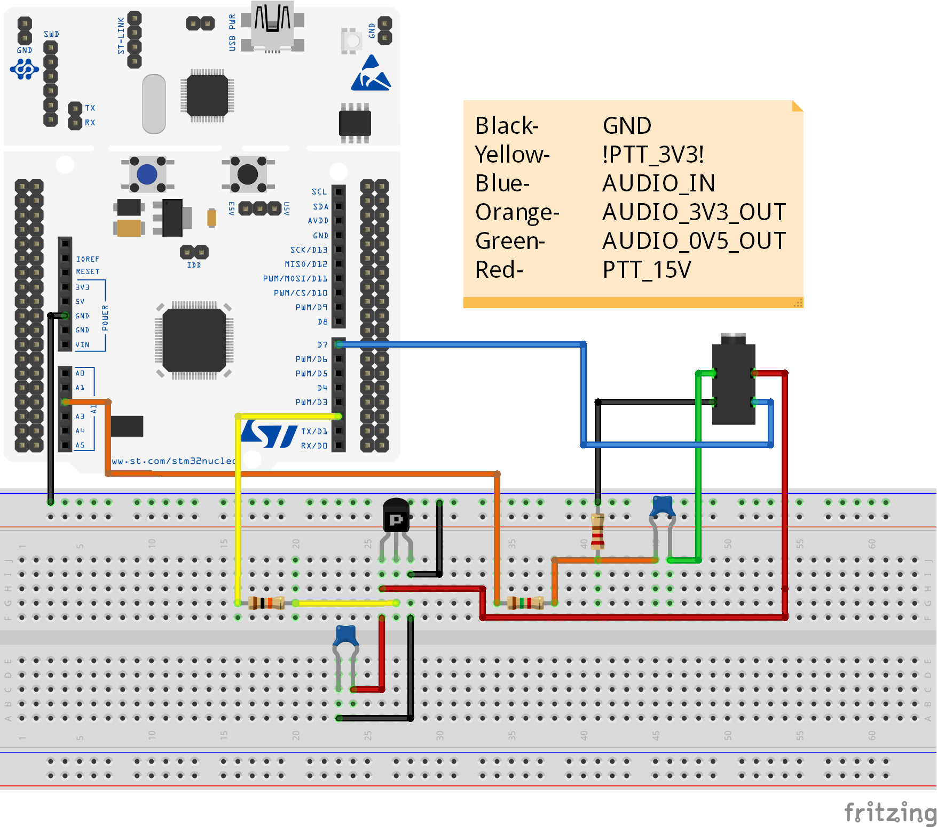
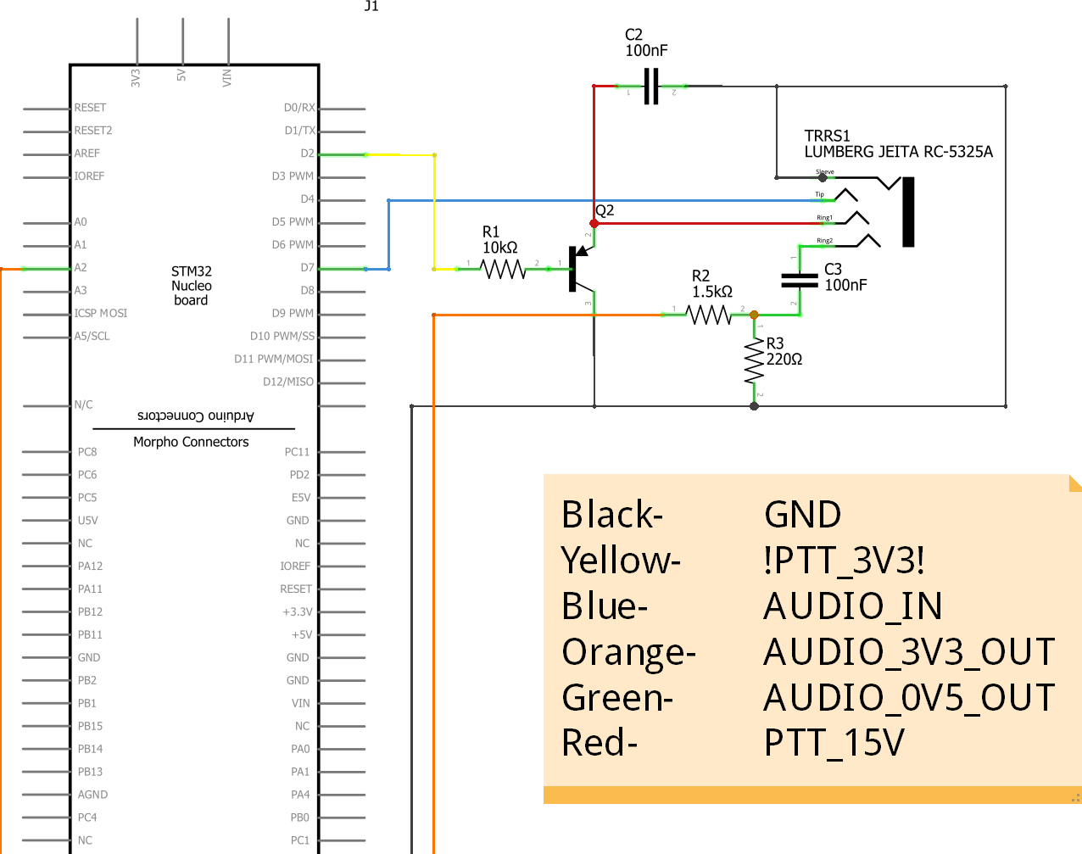
Modular Wring Schematic

Slide 20
Acknowledgements
Project Mentors:
Mr. Nolan Edwards
Mr. Rizwan Merchant
Mr. Nick Pugh
Mr. James Palmer
Special Thanks:
CAPE Team
Pelican Engineering

Slide 21
Questions?

